Slide 1
The Dairy Farmer
Margin Protection Program
USDA’s Safety Net
For Producers:
2016 Enrollment Update
Notes:
This slide presentation explains some of the key features of the new federal dairy safety net program, called the dairy Margin Protection Program. The National Milk Producers Federation and its members were instrumental in the enactment of this program as part of the 2014 farm bill … and we worked closely with USDA on the rules implementing the program last year. We believe the margin protection program, or MPP for short, will be an important program for the U.S. dairy farmer community in the years ahead.

Slide 2
What the Farm Bill Did
Created
Margin Protection Program
Dairy Product Donation Program
Repealed
Dairy Product Price Support Program
Dairy Export Incentive Program
Extended
Dairy Forward Pricing Program
Dairy Indemnity Program
Federal Order Review Commission
Milk Income Loss Contract Program
Notes:
Congress actually established two programs in the 2014 farm bill to help provide an improved economic safety net for dairy farmers … the Margin Protection Program and a Dairy Product Donation Program. This presentation mostly focuses on the MPP, but will later mention how the donation program also helps dairy producers. These two programs replaced price supports, the Milk Income Loss Contract – or MILC -- program, the Dairy Export Incentive Program, and several smaller programs. Two other important programs -- forward contracting and the Dairy Indemnity Program -- remain on the books.

Slide 3
Margin Protection Program
A voluntary risk management program for the 21st century
Protects producers’ equity and margins, rather than supporting milk prices
Administered by USDA’s Farm Service Agency
No payment limitations based on income or herd size
Notes:
The Margin Protection Program is a voluntary risk management program for the 21st century. It protects producers’ margins, rather than supporting milk prices … and it treats producers equitably. There are no limitations based on income or herd size; there are different coverage premiums for larger farms.

Slide 4
Margin Protection Program
Sign-up for 2016 opened July 1st and continues through September 30th. This enrollment window pattern will continue for the remainder of the Farm Bill
Farms must be selling milk commercially to qualify
Producers pay $100 Registration fee and cannot opt out once they register; producers that signed up must continue to pay their annual $100 Administrative fee
Notes:
Sign-up for the 2016 Margin Protection Program opened on Wednesday July 1, and continues until Wednesday September 30, 2015. Subsequent enrollment windows will occur in the same time period every summer. Sign-up will be with USDA through local Farm Service Agency offices. To enroll, producers must be able to document their production history and that they are currently engaged in the production and commercial marketing of milk. Once producers sign up, they are in the program until the 2014 farm bill expires at the end of 2018. Each year, however, they can adjust their coverage level for the following year.

Slide 5
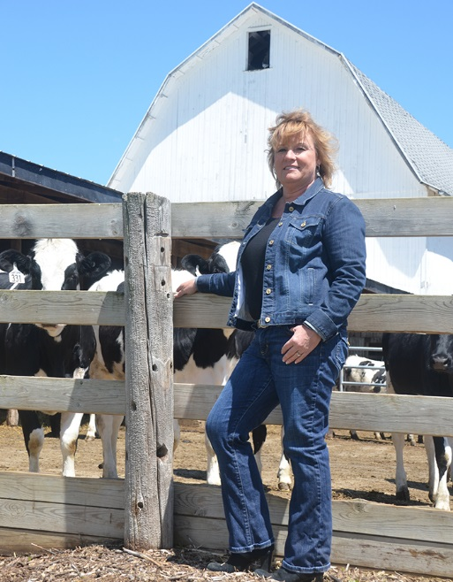
Margin Protection Program
What’s a farm?
What’s the margin?
What’s your production history?
Annual decisions
Fees and premiums
Payments to producers
Notes:
In the slides that follow, we’ll look at the definition of a farm; how the margin calculation is made; how production history is determined; the annual decisions producers must make; MPP’s various fees and premiums; and, finally, how payments to producers will be calculated.

Slide 6
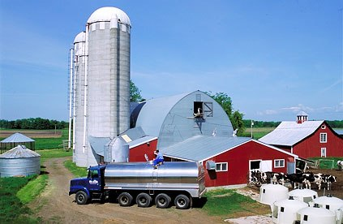
What’s a Farm?
A dairy operation producing milk commercially
Similar rules to those under MILC
Multiple producers involved with one operation are a single farm
Multiple farms operated by a single producer register separately
Notes:
For purposes of this program, a dairy farm is any operation producing and commercially marketing milk. As with the MILC program, multiple producers involved in one operation are considered a single farm … while multiple farms operated by a single producer will register separately.

Slide 7
New Farm
A new dairy operation is separate and distinct from any other operation
USDA will use an ‘affiliation’ rule to determine whether new operations can be established by producers with ownership in other farms
Farmers that collectively own more than 50% interest in the new operation are not considered separate if they also own 50+% interest in another operation already registered in MPP
Notes:
A new dairy farm must be separate and distinct from another farm and be one which has no production history in calendar years 2011, 2012 or 2013. New dairy farmers will be able to establish production history if they’ve had no financial interest in other farms. Established farmers may be able to form a separate new farm, with a new production history, under an “affiliation rule” established by USDA. This rule may allow established farmers, under certain conditions, to be part of a new operation if their business interest in an existing dairy farm has been limited. Additional information from USDA will be necessary to determine the exact circumstances under which the affiliation rule might apply.

Slide 8
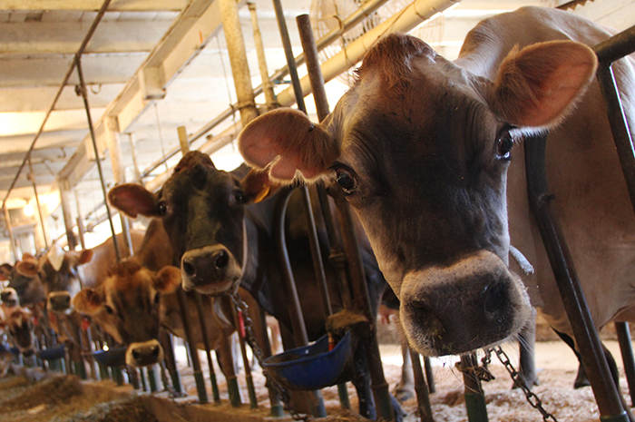
New Farmers on Farm
USDA will issue a rule this fall addressing matters related to allowing family members to expand production history on a family operation, as well as other issues of interest, such as flexibility on premium payments
Notes:
USDA will issue a new rule sometime in the fall on the issue of potentially allowing some expansion in production history to accommodate family members joining an established operation. In addition, USDA will address other issues of interest to dairy producers.

Slide 9
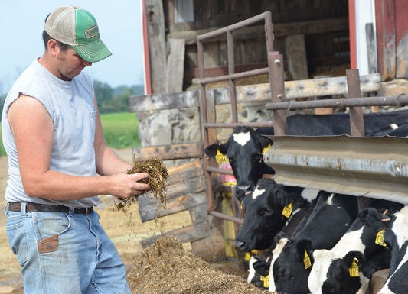
What’s the Margin?
A national average margin, not your individual margin
The all-milk price minus average feed costs, computed from a formula using national benchmark prices of corn,
soybean meal and alfalfa hay
Reflects costs of feeding all dairy animals on a farm on a hundredweight basis
Notes:
For purposes of this program, the margin is a national average margin, not the actual margin on your own farm. USDA will compute it using the national all-milk price and national average feed costs. Feed costs will be computed through a formula using national benchmark prices for corn, soybean meal and alfalfa hay. The formula will reflect the cost of feeding all the dairy animals on a farm, not just the cows being milked. The margin is the difference between the U.S. all-milk price and national average feed costs.

Slide 10
What’s the Margin?
All-Milk Price
Reported monthly by USDA’s National Agricultural Statistics Service
Includes premiums
Excludes hauling costs
Best measure of average prices received by U.S. dairy farmers
Notes:
The all-milk price is reported monthly by USDA’s National Agricultural Statistics Service. It includes premiums but excludes hauling costs.
As a national average price, it is considered the best measure of milk prices received by dairy producers.

Slide 11
What’s the Margin?
National Average Feed Cost calculation using …
USDA Ag Prices report for corn/bushel
USDA Ag Market News Central Illinois soybean meal/ton
USDA Ag Prices report for alfalfa hay/ton
National Average Cost of Feed Calculation
= 1.0728 X U.S. average corn price/bushel
+ 0.00735 X Central Illinois soybean meal price/ton
+ 0.0137 X U.S. average alfalfa hay price/ton
Notes:
These are the official sources USDA uses for feed prices and it will compute average feed costs. Note that soybeans are priced as soymeal, per ton, not per bushel. While the national margin will likely vary from your farm’s own margin, trends in national conditions typically are experienced on individual farms across the country.

Slide 12
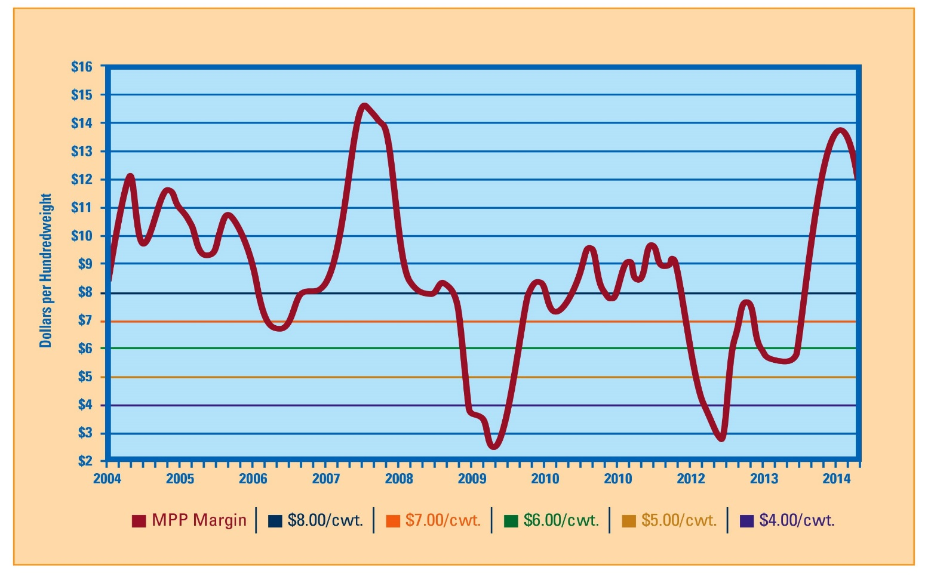
What’s the Margin?
Notes:
This line graph uses USDA’s formula to show average margins over the last decade. Since 2004, the average margin has been around $8.50 per hundredweight.
But within that average are some wild swings up and down. The margin dropped below $3 in 2009 and again in 2012. More recently, it topped $15 thanks to 2014’s record milk prices. The line in purple is the $4 margin level, where free, catastrophic coverage would have kicked in. The $8 maximum protection level is in dark blue. In effect, the Margin Protection Program protects producers from the worst effects of those dips in the average margin. Higher levels of MPP coverage generate more frequent and greater support, at a higher cost for the premiums.

Slide 13
What’s Your Production History?
Initially equals the highest production in either 2011, 2012 or 2013
Yearly increases based on average growth in national production
Since USDA determined milk production increased 2.61% in 2014, those in the program will see production history increase by 2.61% for 2016
Expansion beyond national average is not insured
New producers extrapolate based on actual production or average milk per cow
Notes:
For this program, production history is set initially as the highest production in either calendar year 2011, 2012 or 2013. Production histories increase yearly based on the average growth in national milk production, as determined by USDA. For example, since USDA determined milk production increased 2.61 percent in 2014, those already in the program will see their production history increase by the same 2.61 percent for the 2016 enrollment year. Any expanded production on an individual farm, beyond the national average, is not insured. If national average production decreases, however, production history will not decrease with it.
New producers, who don’t have an actual, 12-month production history, can use an estimate, based on their actual production for the months in which they have produced milk, and extrapolate that to a 12-month total. Or they can use their herd size multiplied by the national average production per cow.

Slide 14
What If You Sell or Move?
If a farm is sold, production history can move with the farmer or stay with the farm, but not both
Producers may combine production histories from different facilities, but those facilities will no longer have a production history
Individual cases will be reviewed by local FSA offices and FSA Washington, and can be appealed
Notes:
If a farm is sold, production history can either move with the producer or it can stay with the farm, but it can’t do both. Producers can also combine production histories from different facilities, but those individual facilities will no longer have their own history. Individual cases will be reviewed by local Farm Service Agency offices and FSA in Washington, and can be appealed.

Slide 15
LGM & MPP
Producers cannot be in both at the same time
Producers in LGM for 2015 can sign up for MPP, if they do so by September 30
Transition will occur after all target marketings under LGM are completed
Producers who have signed for MPP cannot go back to LGM
Notes:
Those in Livestock Gross Management Program for 2015 can switch to the Margin Protection Program when their LGM contract ends. But to do that they must sign up for MPP by September 30, 2015. They will transition to MPP after all target marketings under LGM are completed next year. Depending on what month that is, there may be a 30-day coverage gap.

Slide 16
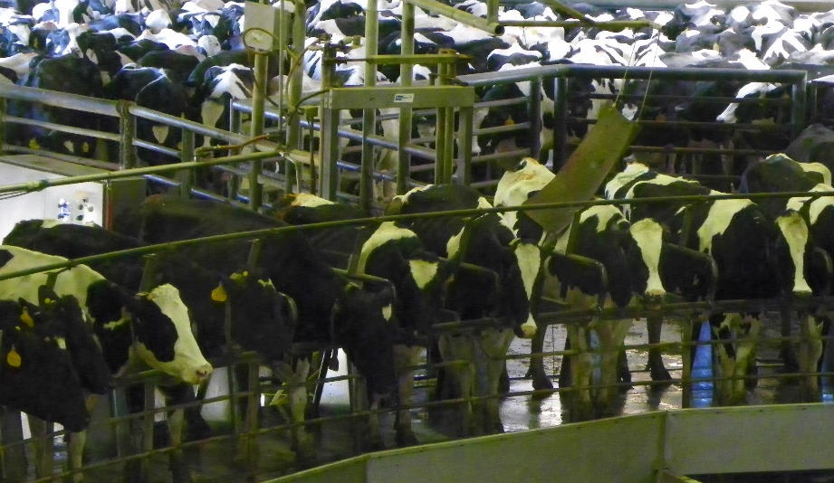
Annual Decisions
Producers can protect between 25% to 90% of production history, in 5% increments
Producers can choose a level of margin protection, from $4/cwt to $8/cwt, in 50¢ increments
Notes:
Dairy farmers signing up for the Margin Protection Program during the current enrollment period have two important decisions to make: how much of their production to protect, and the margin level they want protected.
They can protect between 25 percent and 90 percent of their production history, in five-percent increments
They can choose a level of margin protection, from $4 per hundredweight to $8 per hundredweight, in 50-cent increments
Producers will make these decisions each year at sign-up, and they can adjust them every year going forward.

Slide 17
Fees and Premiums
$100 annual administrative fee provides catastrophic coverage for margins below $4/cwt
No premium at $4/cwt
Annual premiums paid by producers for protection at higher levels: $4.50 to $8.00/cwt
Notes:
This program can cost producers as little as a $100 per year. For that annual administrative fee, farmers receive basic, catastrophic margin coverage at the $4 per hundredweight level. For higher levels of margin coverage, a premium is required. Premiums equal a farmer’s milk production history, multiplied by the percentage of production history covered, multiplied by the premium rate for the level of coverage selected.

Slide 18
Fees and Premiums
For now, producers will either pay the full premium at sign-up, or:
Pay 25% by February 1, and …
75% by June 1
NMPF is urging USDA to provide flexibility to pay premiums through milk check deductions
Notes:
For those who buy coverage above the free, $4-per-hundredweight coverage level, there are two options for paying premiums: pay 100 percent at the time of sign up, or pay 25 percent by February 1 and the balance by June 1. NMPF continues to urge USDA to provide additional payment plans, including paying through monthly milk check deductions. But, right now, these are the two options available.

Slide 19
Premium Rates
Margin Level Coverage | First 4 Million Pounds | More Than 4 Million Pounds
$4.00 | No cost | No cost
$4.50 | $0.010 | $0.020
$5.00 | $0.025 | $0.040
$5.50 | $0.040 | $0.100
$6.00 | $0.055 | $0.155
$6.50 | $0.090 | $0.290
$7.00 | $0.217 | $0.830
$7.50 | $0.300 | $1.060
$8.00 | $0.475 | $1.360
Dollar amounts are per hundredweight
Notes:
Here’s what the premium rates look like, per hundredweight, at different margin coverage levels. At a margin coverage level of $4, there are no premiums. Premiums start at the $4.50/cwt level and increase as the margin protection level increases. A key point: USDA agreed with NMPF that the lower MPP premium rates apply to the first 4 million pounds of annual milk production enrolled in the program, even for farms insuring more than 4 million pounds. That will be a cost savings for farmers producing more than 4 million pounds of milk per year.

Slide 20
Calculating Your Premium
If PH X Coverage % is under 40,000 cwt …
Premium = (PH X Cov%) X Lower Premium Rate
If PH X Coverage % is over 40,000 cwt …
Premium = 40,000 X Lower Premium Rate
+ [(PH X Cov%) – 40,000] X Higher Premium Rate
Notes:
Here are the formulas for calculating premiums. If coverage extends beyond 4 million pounds per year, the premium will be at the lower rate for the first 4 million pounds, with the remainder reflecting the higher premium rates.

Slide 21
Examples of Premium Costs
Dairy Size |  | 100 Head | 500 Head | 1,000 Head
Milk Production History (pounds) |  | 1,967,397 | 11,304,071 | 24,641,052
90 Percent Covered (pounds) |  | 1,770,657 | 10,173,664 | 22,176,947
Margin Protection Coverage | $4.00 | No cost | No cost | No cost
 | $4.50 | $177 | $1,635 | $4,035
 | $5.00 | $443 | $3,469 | $8,271
 | $5.50 | $708 | $7,774 | $19,777
 | $6.00 | $974 | $11,769 | $30,374
 | $6.50 | $1,594 | $21,504 | $56,313
 | $7.00 | $3,842 | $59,921 | $159,549
 | $7.50 | $5,312 | $77,441 | $204,676
 | $8.00 | $8,411 | $102,962 | $266,206
Notes:
This table shows how much three different-sized operations would pay for varying levels of margin coverage. Again, at the $4 coverage level, no premiums are owed. Premiums increase as the operations get larger and the margin protection coverage increases.

Slide 22
Calculating Your Premium
Example 1
Production History (PH) = 5 million pounds
= 50,000 cwt
Coverage percentage (Cov%) = 75%
Margin coverage threshold = $6.50 per cwt
Premium = (50,000 X 75%) X $0.090
= 37,500 X $0.090
= $3,375
Notes:
Here’s an individual example. It shows a hypothetical operation with a production history of 5 million pounds. This farm elects to cover 75 percent of its production history at a margin coverage threshold of $6.50. The annual premium for that farm is $3,375. Because 75 percent of 5 million is 3.75 million pounds, the lower premium, below 4 million pounds, applies to all of this farm’s covered milk production.

Slide 23
Calculating Your Premium
Example 2
Production History (PH) = 10 million pounds
= 100,000 cwt
Coverage percentage (Cov%) = 75%
Margin coverage threshold = $6.50 per cwt
Notes:
On the next two slides, the same coverage level of 75% applies, but for an operation with a production history of 10 million pounds. The computations are more complicated because 75 percent of 10 million pounds is more than 4 million pounds. The next slide illustrates how the higher premium rates applies above 4 million pounds.

Slide 24
Calculating Your Premium
Example 2
Premium = 40,000 X $0.090
+ [(100,000 X 75%) – 40,000] X $0.29
= $3,600 + [75,000 – 40,000] X $0.29
= $3,600 + 35,000 X $0.29
= $3,600 + $10,150
= $13,750
Notes:
In this case, the first 40,000 hundredweights – 4 million pounds of milk – results in a premium of nine 9 cents, just as the previous farm did on its 3.75 million pounds of milk. But, in this case, the remaining 3.5 million pounds of covered production, the amount above 4 million pounds, requires a premium of 29 cent per hundredweight. The combination of lower rates and higher rates results in a total premium of $13,750.

Slide 25
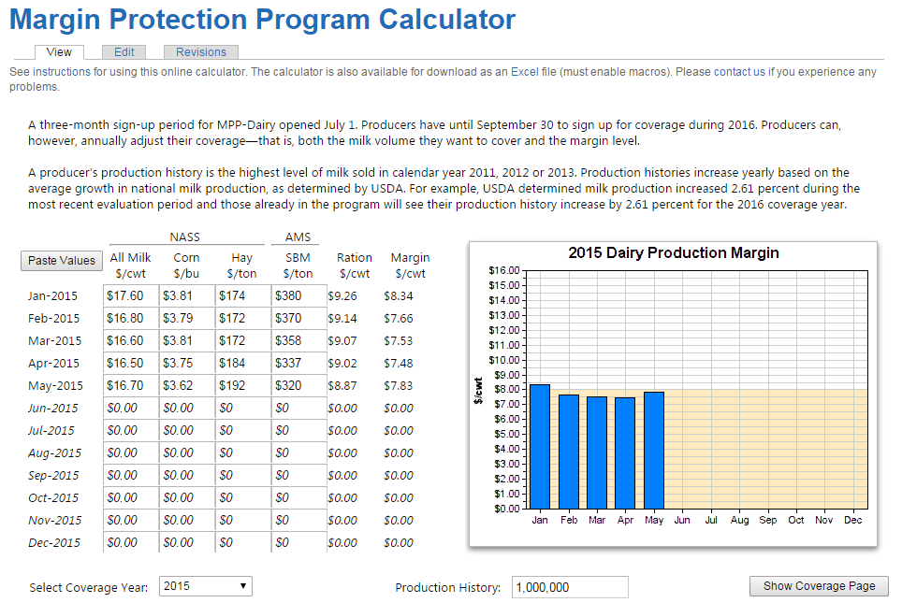
Calculating Your Premium
Notes:
To further help producers make their coverage decisions, NMPF has an online tool allowing producers to input their own numbers and see the program’s potential impact on their farms. This tool is downloadable as an Excel file, in addition to being available on our websites. This calculator allows you to enter not just your own farm’s milk production history and level of coverage, but also you own forecasts for milk prices, as well as feed costs. It will help you estimate your coverage needs based on where you believe milk and feed costs will be, in the year for which you’re selecting coverage.

Slide 26
Payments to Producers
Program pays when average margin for 2-month period is below the margin selected by the producer
2-month periods are: January-February, March-April, May-June, July-August, September-October, November-December
Program pays on one-sixth (or two months’ worth) of production history, multiplied by percent coverage selected
Notes:
The Margin Protection Program pays benefits when the average margin for specific, two-month periods is below the level selected by the producer.
At that point it pays on one-sixth of a farm’s production history – that is, two months’ worth of production history – multiplied by the percentage of production history coverage the producer has selected. Let’s see how that plays out using our earlier example.

Slide 27
Example
Margin Protection Payment Calculation
Annual Production History 10,000,000 lbs.
% Coverage 75%
Annual Volume Covered 75,000 cwt
Volume Covered per 2 month period 12,500 cwt
(one-sixth of total)
Coverage Threshold for year $6.50 per cwt
Actual Margin for 2 month period $5.90 per cwt
Margin Difference for 2 month period $0.60 per cwt
Notes:
Here’s that second farm, with a production history of 10 million pounds, a coverage level of 75 percent, and a margin protection of $6.50 per hundredweight.
This example assumes an actual margin for one two-month period of $5.90, or 60 cents less than the $6.50 margin protection the producer is paying for.

Slide 28
Example
Margin Protection Payment Calculation
Annual premium paid to USDA $13,750
Premium paid per period $2,292 Premium per cwt $0.183
Margin Protection Payment for period $7,500
(12,500 cwt X $.60/cwt)
Notes:
Recall that this producer’s annual premium was $13,750. For two of those 12 months, that’s $2,292. The MPP payment to the producer for those two months is $7,500. So in this example the producer comes out more than $5,000 ahead during that two-month period.

Slide 29
What If There Was MPP in 2012?
Dairy Size | 100 Head | 500 Head | 1,000 Head
Milk Production History (pounds) | 1,967,397 | 11,304,071 | 24,641,052
90 Percent Covered (pounds) | 1,770,657 | 10,173,664 | 22,176,947
Premium ($6.50 Margin Protection) | $1,594 | $21,504 | $56,313
March-April Margin: $4.59 | $5,635 | $32,376 | $70,573
May-June Margin: $3.48 | $8,922 | $51,266 | $111,751
July-August Margin: $2.88 | $10,697 | $61,460 | $133,972
Net 2012 Return | $23,660 | $123,598 | $259,984
Notes:
Here’s a look at what would have happened to three different-sized operations had MPP been in effect in mid-2012. The examples include net returns if each farm covered 90 percent of its output at the $6.50 margin level. Premiums and payments are shown for three two-month periods. The bottom lines are their net MPP returns to the three operations. Note that these calculations were made using the higher premium rates in place after 2015.

Slide 30
Timeline for Payments
Producers will receive payments shortly after the margin cost calculations are made final
Example: If a payment is triggered for January-February, the margin will be announced at the end of March and payment will be sent out in early April
Notes:
When payments are triggered under the Margin Protection Program, payments are made shortly after the official, final margin cost calculations are made for a two-month period. For example, if a payment is triggered for January and February, the final margin will be calculated and announced at the end of March, and payment will be sent in early April to those covered.

Slide 31
Dairy Product Donation Program
Addresses critically low margins
Stimulates demand, and helps
both producers and those in need
How it works…
Triggered by margins below $4/cwt for 2 months
Buys consumer-ready dairy products at prevailing prices
Must not displace commercial sales
Notes:
The other program Congress created in the 2014 farm bill to help dairy farmers, the Dairy Product Donation Program, is designed to address critically low margins. It will be triggered if margins are below $4 per hundredweight for two consecutive months. USDA will purchase consumer-ready dairy products for donation to food banks and other feeding programs serving low-income consumers. It will buy products at prevailing prices, and the products must not displace commercial sales. This is not your father’s price support program. It’s designed to have maximum short-term impact, without creating mountains of powder that hang over the market long-term. This is a win-win. Simultaneously, the program will stimulate demand, help dairy farmers when they need it most, and provide additional food to those in need.

Slide 32
Final Thoughts
MPP capped 5 years of work by NMPF, dairy co-ops and individual producers
MPP is more flexible, comprehensive and equitable than any previous federal dairy safety net
MPP is designed to protect against 2009-type catastrophic losses and bad margins like those seen in 2012
Notes:
The launch of the program in 2014 capped five years of work by NMPF, its member cooperatives and many dairy producer groups. The program is more flexible, more comprehensive and more equitable than any previous federal dairy safety net. It will help protect against a repeat of 2009-type catastrophic losses.

Slide 33
Final Thoughts
NMPF strongly encourages farmers to use MPP going forward
To help make decisions, NMPF website www.futurefordairy.com has …
Detailed summaries of the program
A copy of this presentation
A tool showing MPP’s potential impact on individual farms
Notes:
NMPF strongly encourages producers to use the Margin Protection Program. To help producers with their decision-making process, additional materials, including the online calculator, are available on www.nmpf.org and www.futurefordairy.com. In addition, USDA has its own materials, including a somewhat different online computation tool.

